Slide 1
ReduCE-Waste Project
Controlling E-waste Imports to Tanzania
Dr. Shahrzad Manoochehri, World Resources Forum Association, Switzerland
Online presentation at: The 5th EACO Regional E-waste Workshop on Sustainable E-waste Management in the East African Region – Dar Es Salaam, Tanzania
Date: Wednesday 22 March 2023

Slide 2
Project partners & Duration
Funding Organization
Implementing Partners
Duration
Start: Jan 2021
End: Oct 2022

Slide 3
Background
Context:
Used electrical and electronic equipment (UEEE) imports into Tanzania from higher income countries mainly via ports
Tanzania welcomes UEEE due to affordable access to EEE
Tanzania is party to the Basel Convention (BC)

Slide 4
Background
Challenge:
UEEE imports often mixed with e-waste
Types and volumes of imported UEEE/e-waste is unknown
Burden on EPR system to be established
Burden on environment and health in Tanzania
Inspectors cannot differentiate UEEE from e-waste at point of import
Unclear how to proceed with identified e-waste

Slide 5
Project objective
Overarching objective: Assess and control imports of e-waste, UEEE and EEE into Tanzania through the following specific objectives:
Implementing and pilot-testing the requirements of the Basel Convention Technical Guidelines on Transboundary Movements of Electrical and Electronic Waste and Used Electrical and Electronic Equipment (BCG) in Tanzania,
Assessing volumes and functionalities of UEEE imports into Tanzania,
Preparing a draft National Guideline based on the national context and needs.

Slide 6
Project approach
Assessment of imported EEE/UEEE/e-waste and importers
Workshops / trainings
Pilot test
Control
Replication in EACO Region

Slide 7
Implementation steps
1. Assessment of imported UEEE/e-waste and imports
2. Analysis of the governance structure and regulatory framework
Mapped national stakeholders, analysed their roles and responsibilities and actions needed for the implementation of the BCGs
Mapped the imports hubs, analysed inspections data, quantified declared imports

Slide 8
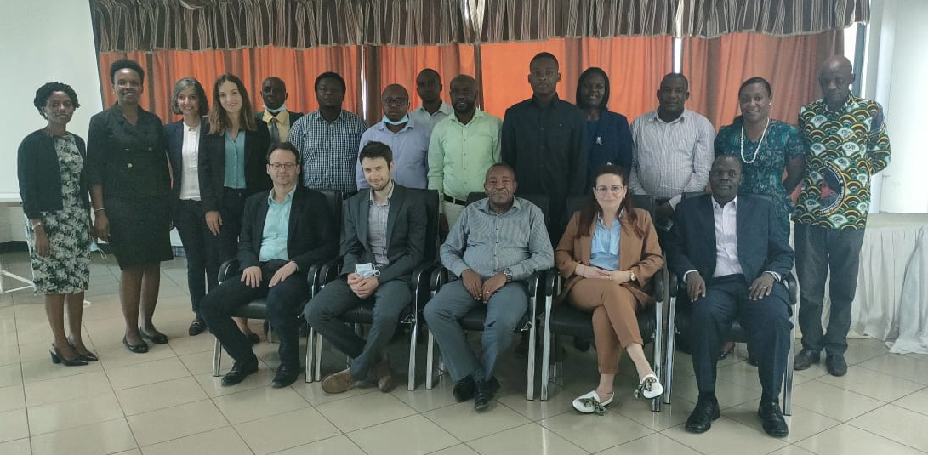
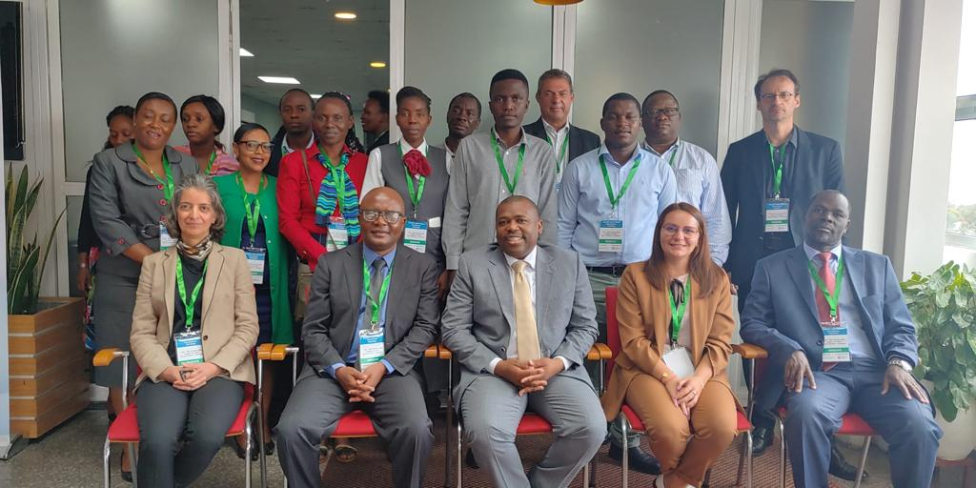
Implementation steps
3. Workshops and trainings
National workshop on the implementation of the BCGs (April 2022, Dar es Salaam)
National training on inspections (April 2022, Dar es Salaam)
International workshop with EACO representatives to discuss the replicability of the approach in other countries (October 2022, Dar es Salaam)

Slide 9
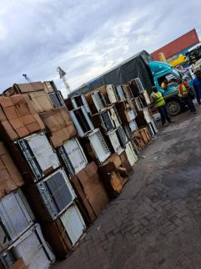
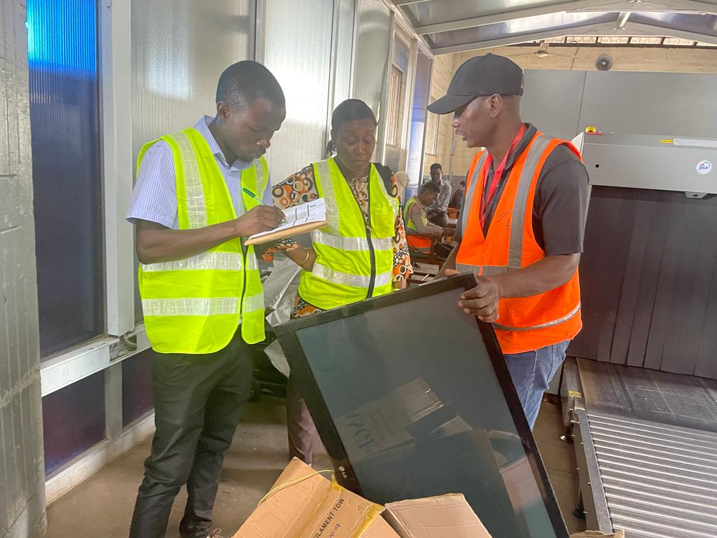
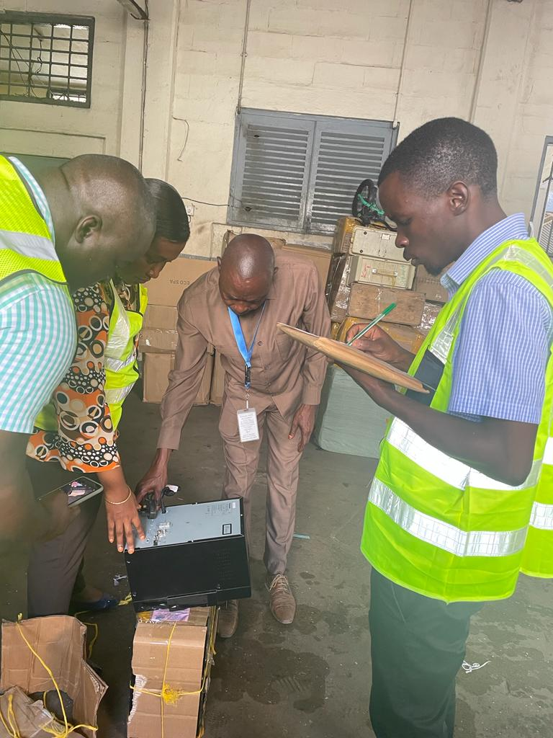
Implementation steps
4. Pilot test on inspections methods at the entry points in DAR
Pilots conducted within the Dar es Salaam ports using the checklist and the BCG guidelines for distinction between UEEE and e-waste
Functionality tests conducted on inspected goods
Data collected on imports quantities and functionalities
Checklist developed for inspections

Slide 10
Implementation steps
4. Pilot test on inspections methods at the entry points
Pilots conducted using guidelines based on BCG
Tests conducted on inspected goods
Data collected on imports quantities and functionalities
5. Evaluation and recommendations
Evaluation of the pilot and roll-out plan for drafting and implanting the National Guidelines
Recommendations for replication in the East Africa region

Slide 11
Key results: Analysis of trade data on imports in Tanzania
Source: TRA (Tanzania Revenue Authority) data from importation documents

Slide 12
Key results: Analysis of inspection data provided by TBS
Source: TBS (Tanzania Bureau of Statistics) data on inspections from February to April 2022

Slide 13
Key results: Origin countries vs total units declared and inspected
Origin country | Units found | Parentage of total | Units inspected | Percentage of total
Hamburg, Germany | 5000 | 82% | 16 | 4%
Used household items | 5000 |  | 16
Sohar, Oman | 10 | 0.2% | 5 | 1%
Personal Effects | 10 |  | 5
UK | 145 | 2% | 18 | 5%
Personal Effects | 145 |  | 18
Zanzibar | 936 | 15% | 352 | 90%
Business for spare parts | 19 |  | 19
Personal Effects | 883 |  | 310
Used goods | 28 |  | 17
Non specified | 6 |  | 6
Total | 6091 |  | 391
Source: Data from pilots conducted at Dar-es-Salaam ports between 21 September to 12 October

Slide 14
Key results: types of products inspected

Slide 15
Enabling conditions for implementation and sustainability of the national guidelines
Enhanced coordination and collaboration among competent Government authorities
Increased collaboration and coordination with relevant authorities in Zanzibar
Build and improve institutional capacity among various governmental levels and sectors
Ports should be equipped with essential infrastructure and inspectors should be supplied with proper equipment
Availability of national standardized testing procedures for different types of UEEE
Availablity and harmonization of data on the amount, type and source of UEEE and e-waste

Slide 16
Requirements for Replicability of the plan in the EACO Region
Need for comprehensive study about the current regulatory and institutional framework in all the EACO countries
Coordinated and harmonized actions, procedures and definitions at regional level
Strengthen collaboration among national statistics officers and port authorities to have access to accurate and harmonized datasets
Full implementation of the Regional E-waste Strategy 2022-2027
Developing regional e-waste recycling and end-processing facilities.

Slide 17
THANK YOU FOR YOUR ATTENTION!
For more information contact:
shahrzad.manoochehri@wrforum.org
vanessa.forti@unitar.org (Ms. Vanessa Forti, UNITAR)
otmar.deubzer@unitar.org (Dr. Otmar Deubzer, UNITAR)

